Slide 1


ADMINISTRATIVE REVIEW
IMPLEMENTATION PLAN
UC Merced Leadership Council December 18, 2019

Slide 2

ADMINISTRATIVE
REVIEW

Slide 3
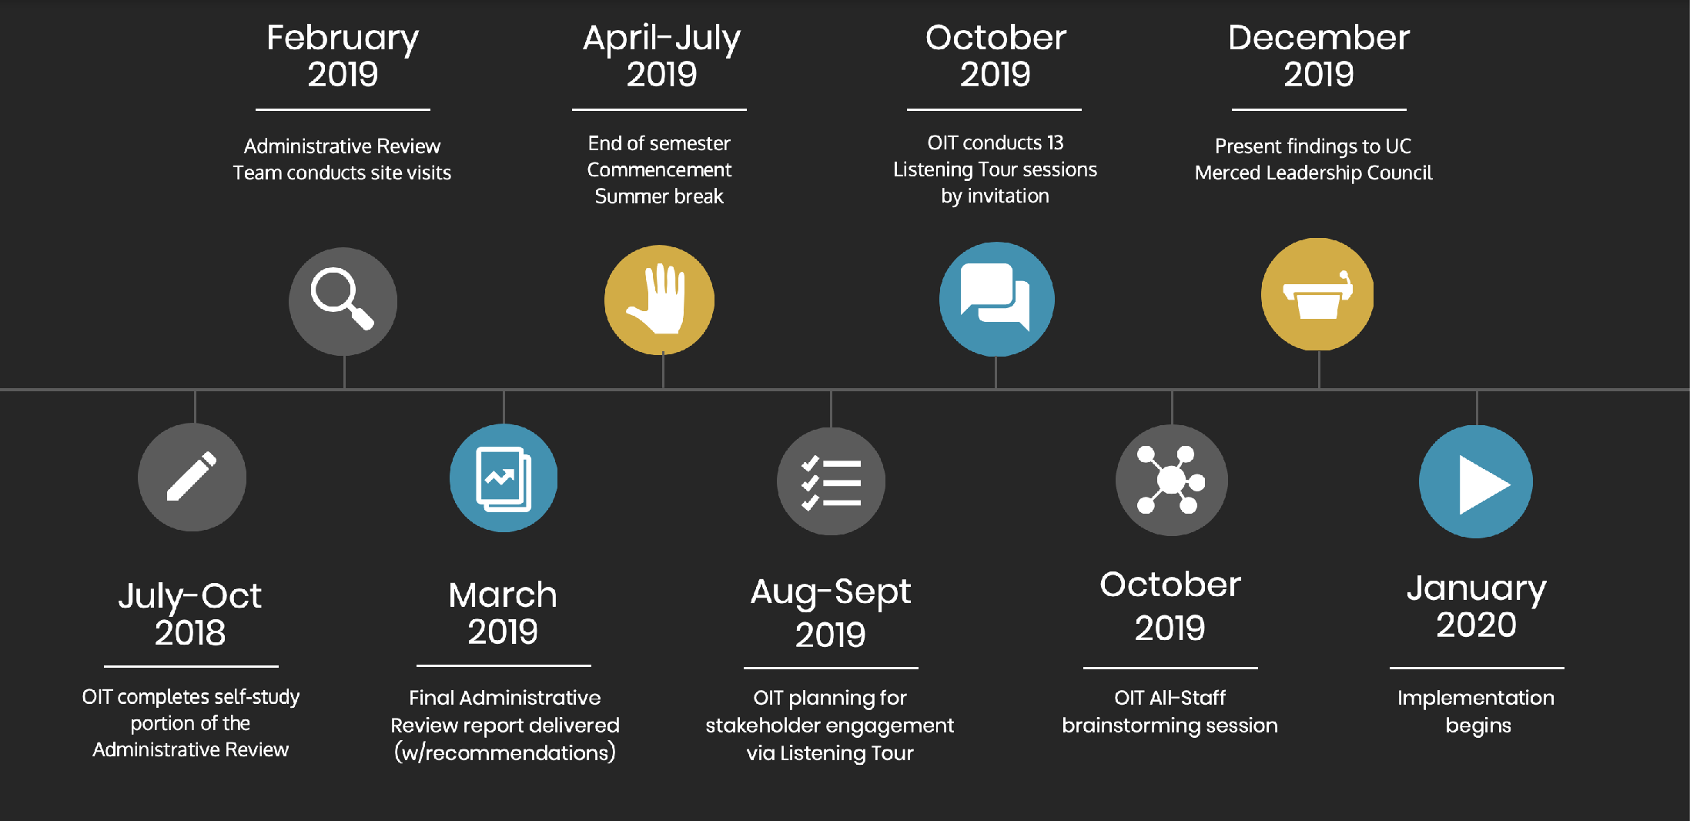
TIMELINE
ADMINISTRATIVE REVIEW

Slide 4
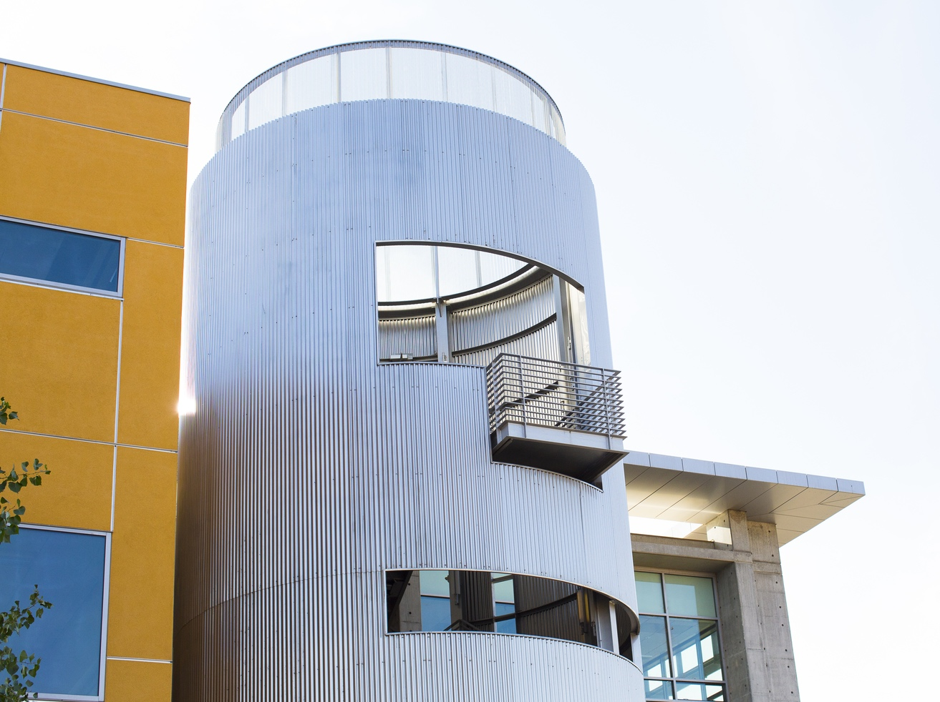
RECOMMENDATIONS
ADMINISTRATIVE REVIEW
ENGAGEMENT IN STRATEGIC PLANNING
EQUIPMENT REVIEW & REFRESH
Increase engagement of
OIT leadership in strategic planning
for the University, initiating their involvement early and often on
campus planning and growth efforts.
Create critical
equipment review and refresh cycles
and fund appropriately.
DEEPER PENETRATION INTO UNIT OPS
STANDARDIZE SERVICES & PRODUCTS
Identify methods and strategies that
allow for deeper penetration of OIT
into unit operations.
Standardize services and products
offered around the campus and
increase outreach to campus partners
to enhance end user understanding
of OIT resources.

Slide 5

LISTENING TOUR

Slide 6
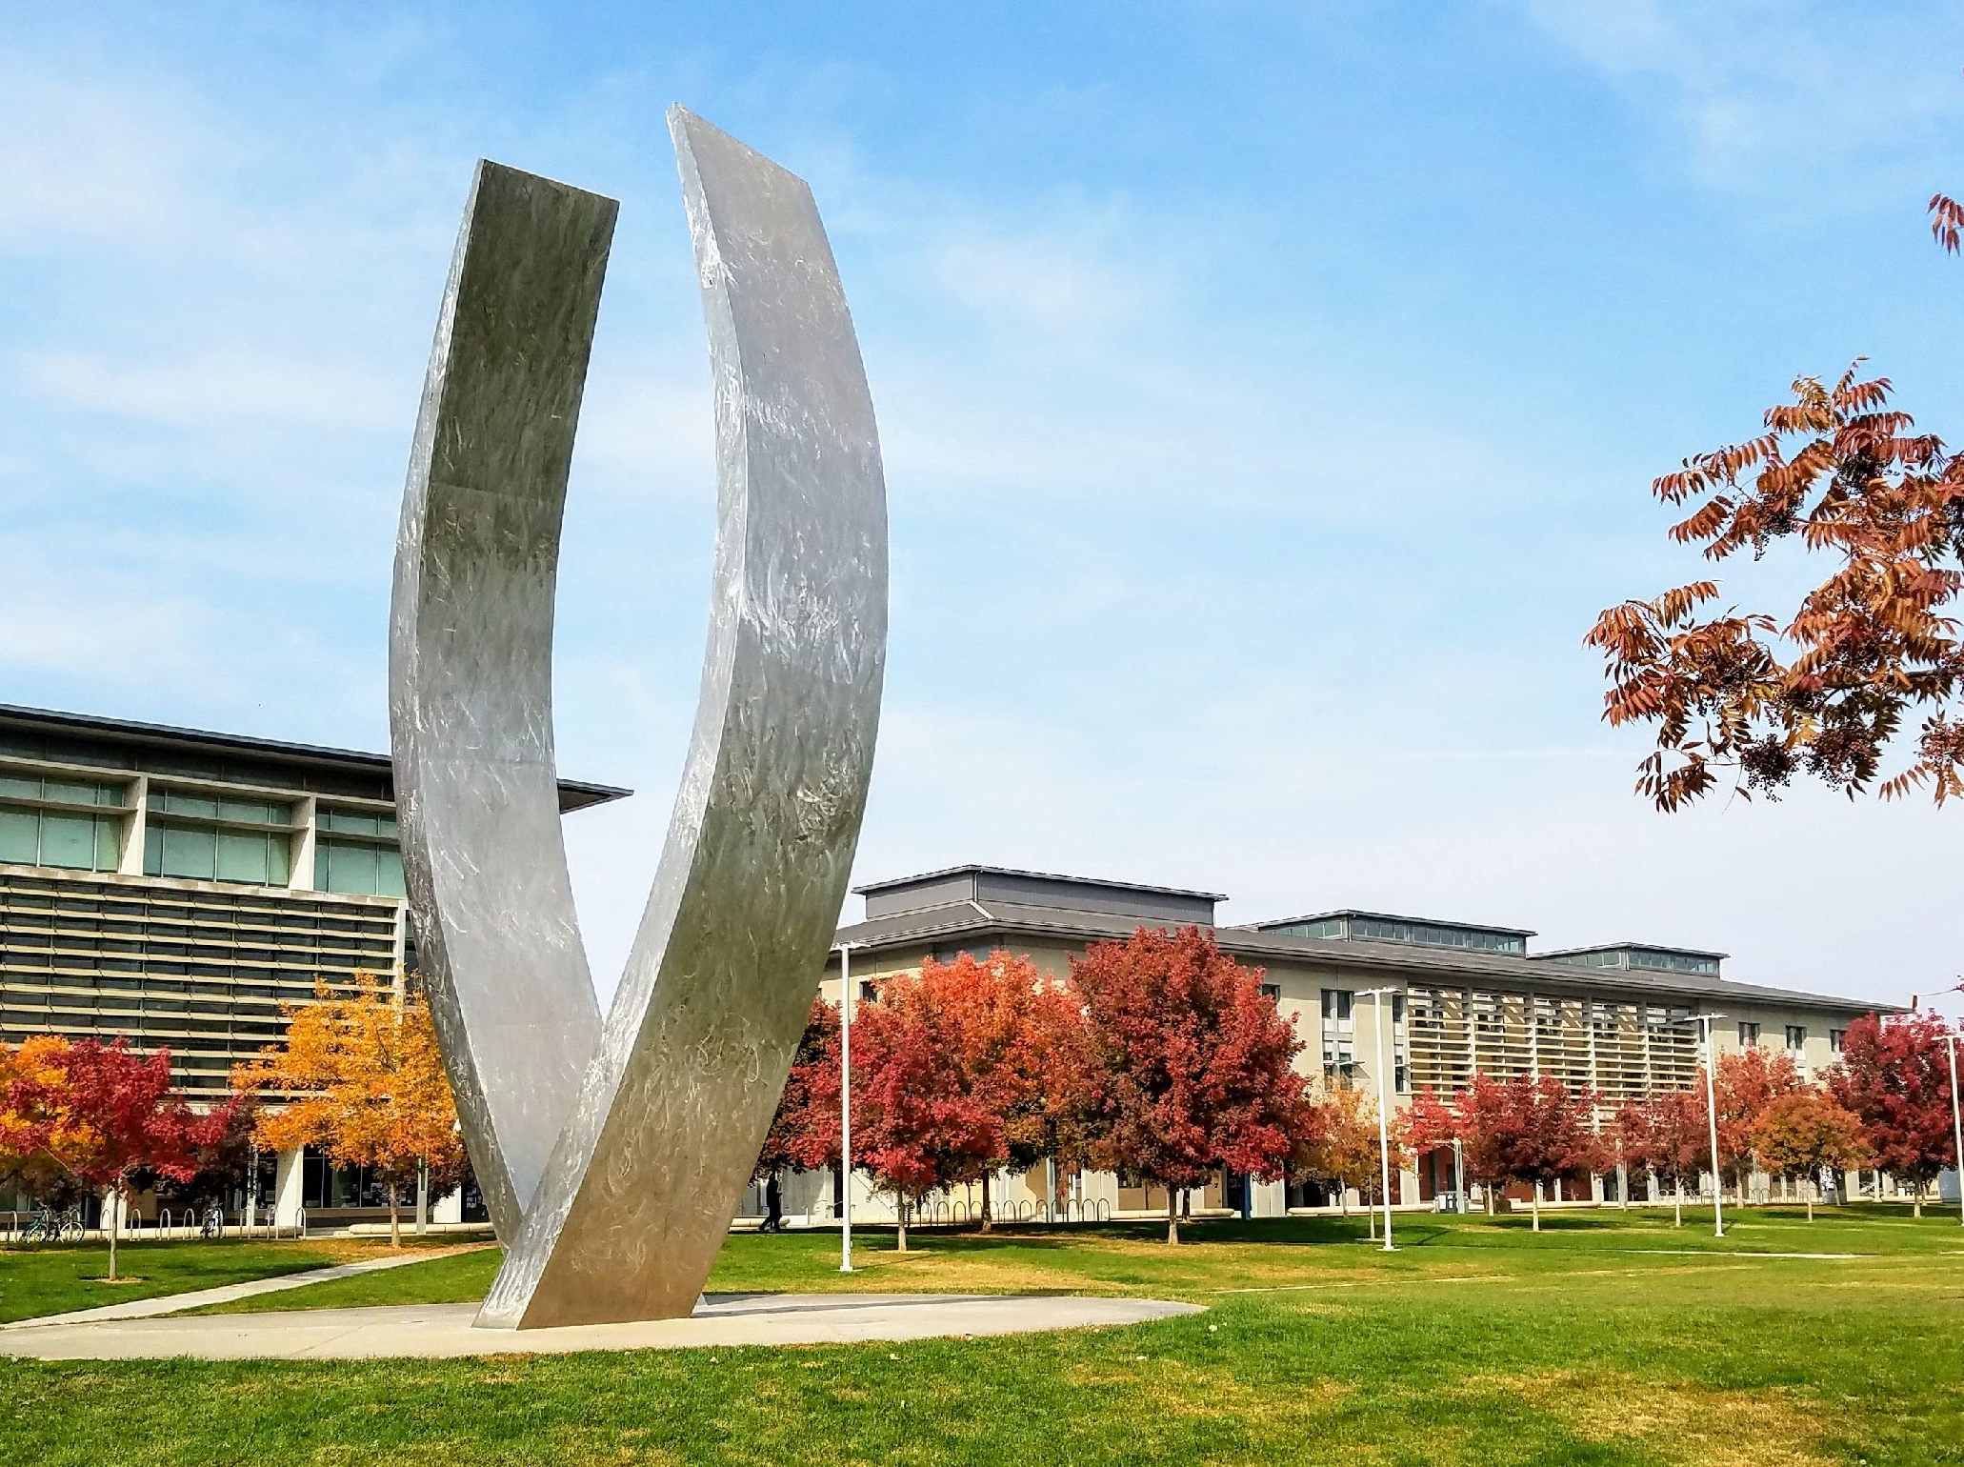
EXECUTIVE CONSTITUENT GROUPS
LISTENING TOUR
STAKEHOLDER ENGAGEMENT
Office of the Provost | 2
School of Natural Sciences | 2
School of Engineering | 2
School of Social Sciences, Humanities and Arts | 2
Vice Provost for Faculty | 1
Vice Provost and Dean of Graduate Education | 1
University Librarian | 2
Vice Chancellor for Student Affairs | 1
Vice Chancellor for Research | 1
Interim Vice Chancellor for Finance and Administration | 1
Vice Chancellor, Chief Operating Officer | 1
Assoc, Chancellor and Chief of Staff | 1
Assoc Chancellor, Chief Diversity Officer | 1
Chief Campus Counsel | 1
What are some of the external forces experienced by your unit that impact your work?
What can OIT do
to reduce the difficulties of these challenges?
What are some of the
qualities of UC Merced’s organizational culture that
may challenge our success?

Slide 7
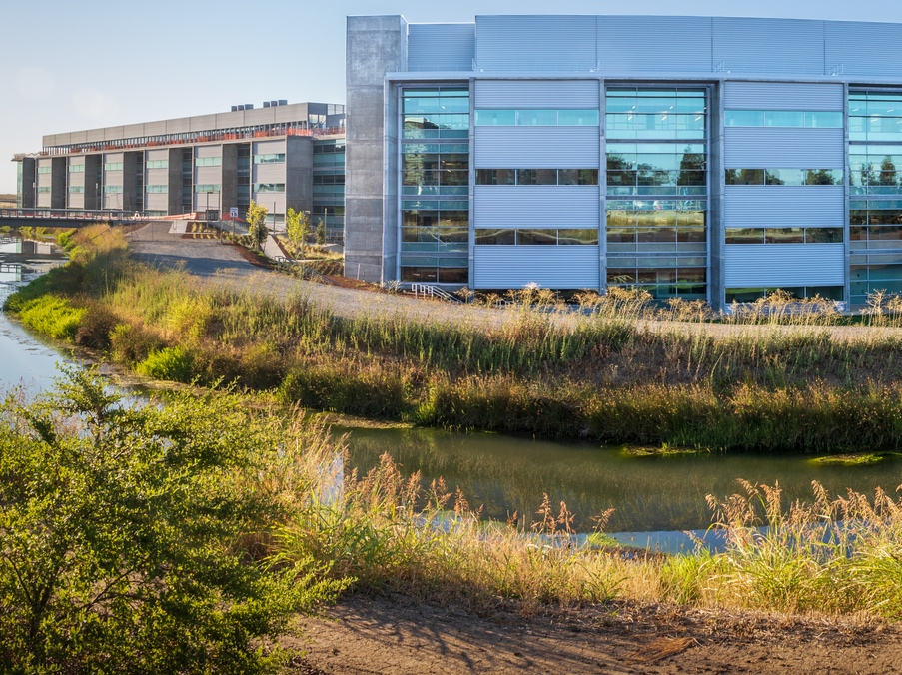
FUNCTIONAL CONSTITUENT GROUPS
LISTENING TOUR
STAKEHOLDER ENGAGEMENT
Administrative Coordination Team
Human Resources
Procurement
Center for Institutional Effectiveness
Athletics
External Affairs
Design & Construction
Facilities
Accounting
Budget Office
Chief Academic Officers
Office of Undergraduate Education
Curriculum Managers
Auxillaries
Department of Public Safety
Enrollment Management
What are the top 5 - 10 applications your unit
uses daily?
What can OIT do to make it easier for you to use these applications?
What are some of the barriers we (UC Merced) face in making technology easier to use?

Slide 8
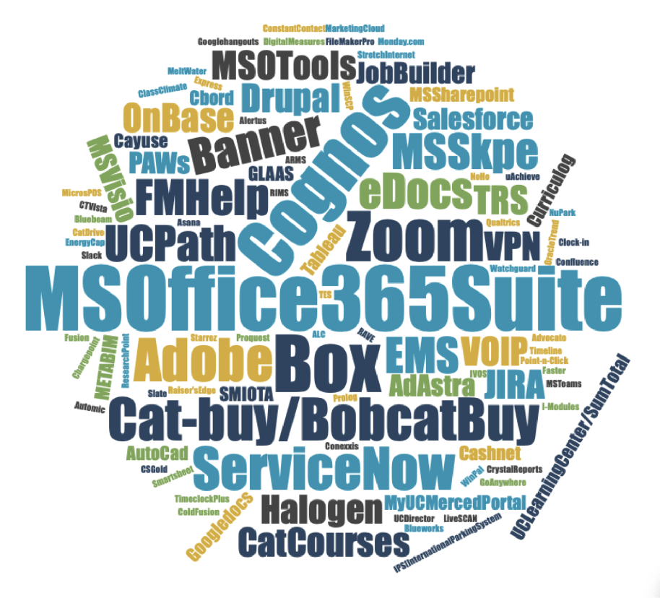
FINDINGS PT.1
What are some of the external forces experienced by your unit that impact your work?
What are the top 5 - 10 applications your unit
uses daily?
EXECUTIVE
FUNCTIONAL
Increased call for accountability, reporting
Global volatility / disruption
Rapid pace of change

Slide 9
FINDINGS PT.2
What can OIT do to reduce the difficulty of these challenges?
What can OIT do to make it easier for you to use these applications?
EXECUTIVE
FUNCTIONAL
More implementation support
Training and communication
Curated views for staff
Leverage common solutions
Help work with vendors
Clarify terms of engagement
Simplify and standardize
Provide guidance, consultation & training

Slide 10
FINDINGS PT.3
What are some of the qualities of UC Merced’s organizational culture that may challenge our success?
What are some of the barriers we (UC Merced) face in making technology easier to use?
EXECUTIVE
FUNCTIONAL
We’re in a constant state of transition
We negotiate many tensions and constraints
We have uneven priorities and misaligned decision-making processes
We don’t have a common language to talk about needs and priorities
We haven’t build a clear information architecture for shared documentation
We incentivize work at the department level (we’re too Balkanized)
We don’t invest in staff learning as a mission-related priority
We don’t prioritize an effort to reduce distractions (friction)
We have unrealistic expectations about how to navigate positive change (e.g. a fear of failure)

Slide 11
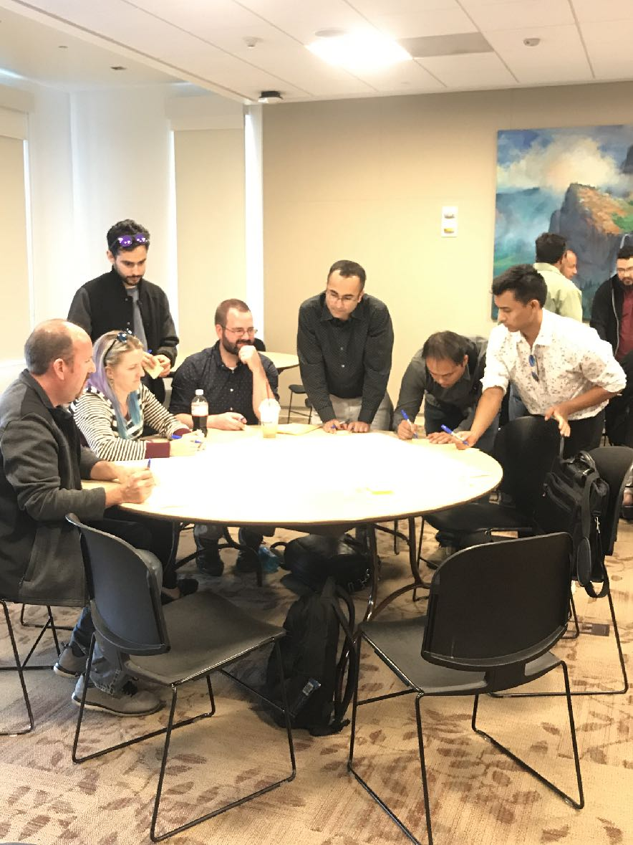
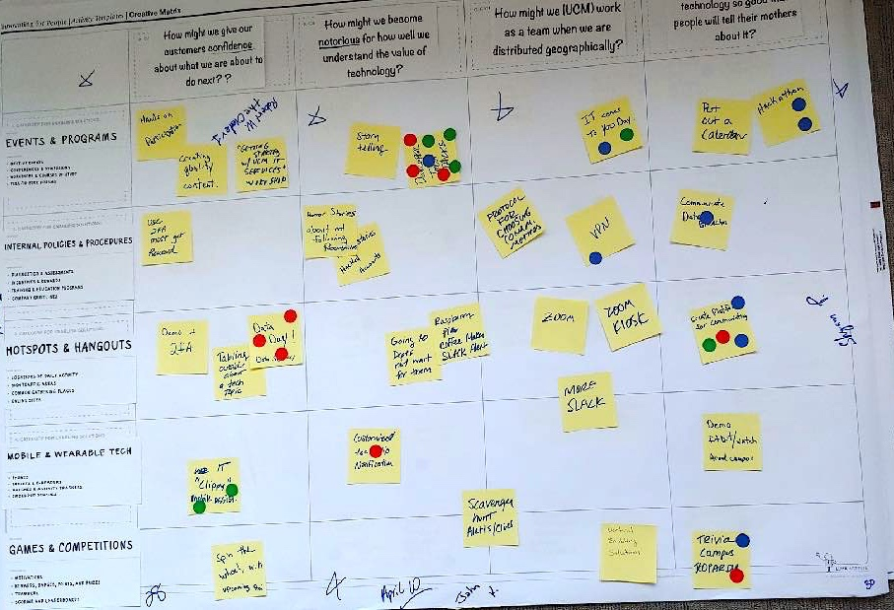
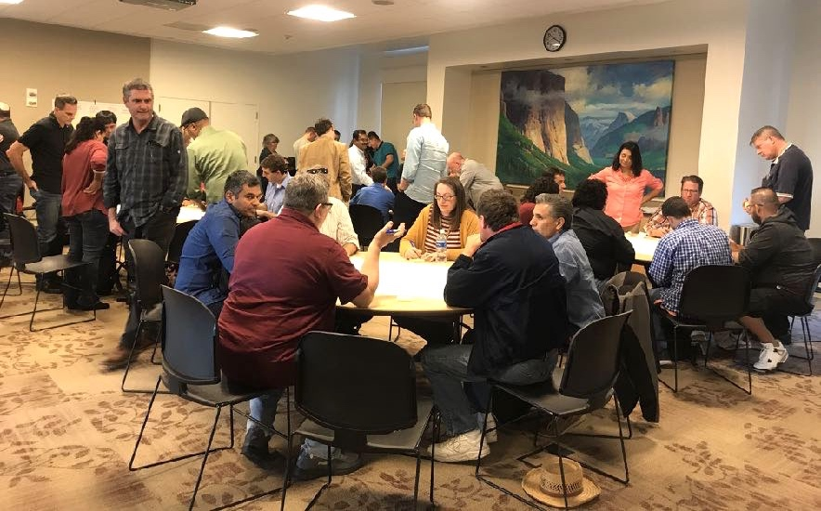
CREATIVE MATRIX EXERCISE
OIT ALL HANDS STAFF MEETING

Slide 12
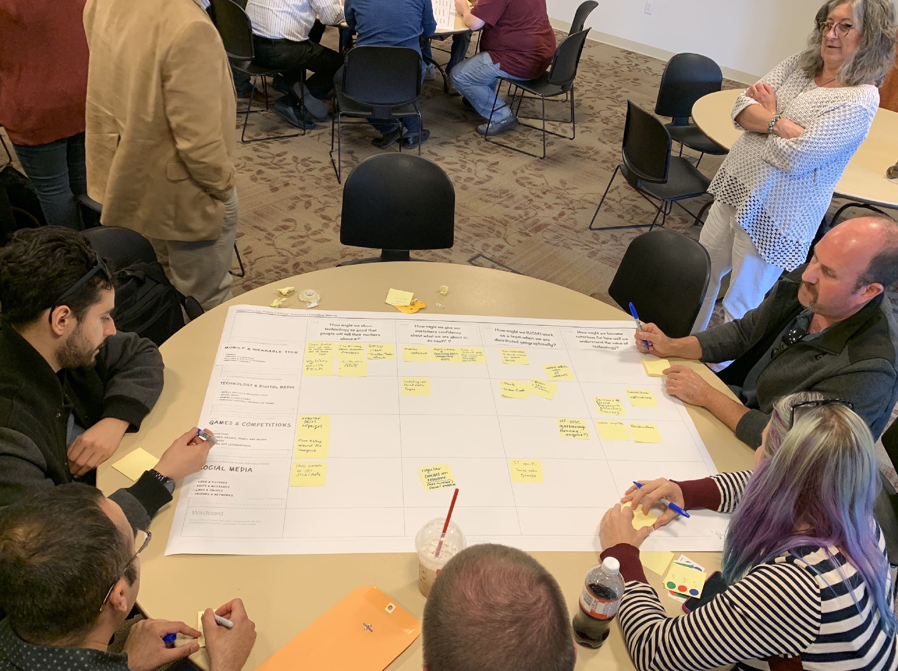
CREATIVE MATRIX
Enabler
Enabler
Enabler
Enabler
Enabler
Enabler
Enabler
Challenge
Question
How might we show technology so good that people will tell their mothers about it?
Challenge
Question
How might we become notorious for how well we understand the value of technology?
Challenge
Question
How might we (UC Merced) work as a team when we are distributed geographically?
Challenge
Question
How might we give our customers confidence about what we are about to do next?

Slide 13
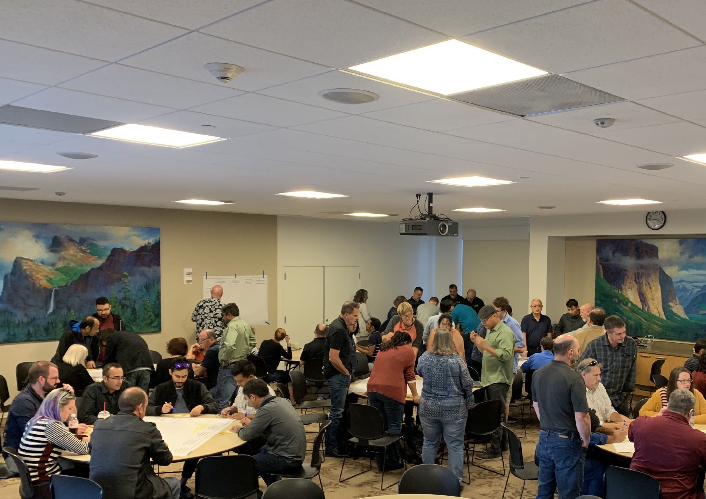
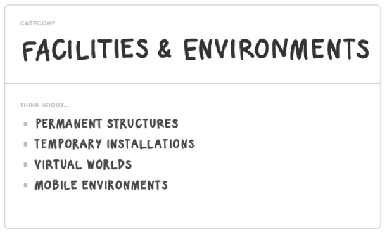

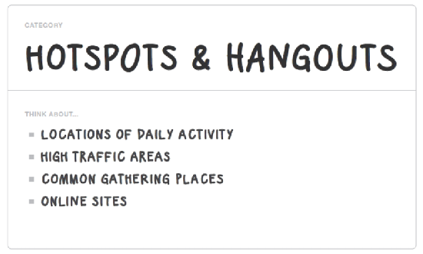
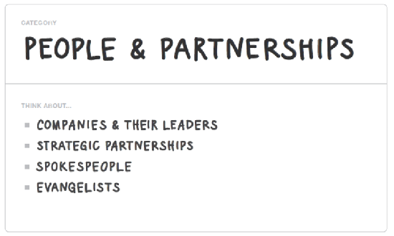
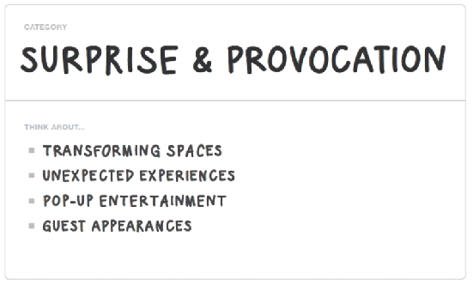

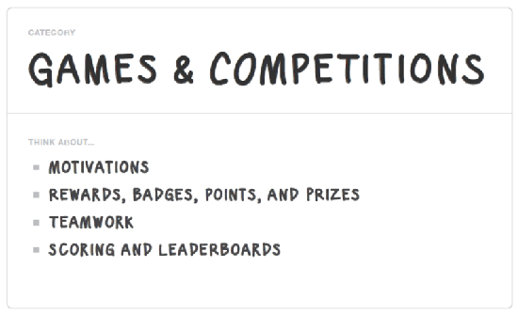
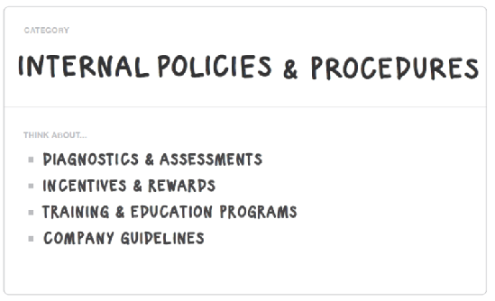
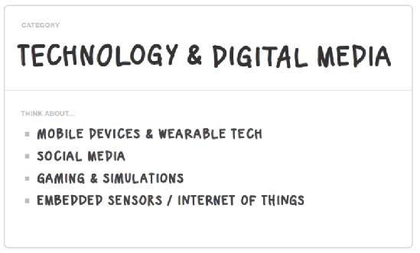

ENABLERS

Slide 14
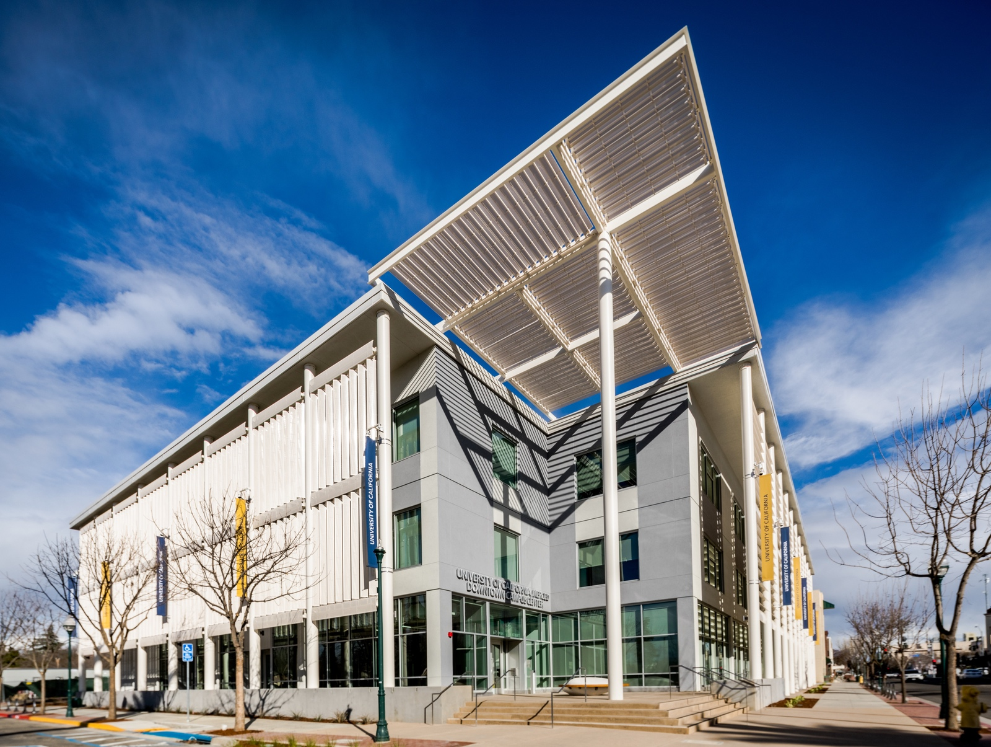
PAIN POINTS

Slide 15

SOFTWARE PURCHASING
PAIN POINTS
campus-wide vs
specialized needs vs personal preferences
EXTERNAL DRIVERS
INTERNAL DRIVERS
Complex licensing models
OIT ACTION:
CAMPUS ACTION:
Coordinate with ACT and Procurement, simplify where possible with self-service
Adopt new streamlined processes

Slide 16
VOIP
PAIN POINTS
EXTERNAL DRIVERS
INTERNAL DRIVERS
Mandates from new construction
Changing market demands
OIT ACTION:
CAMPUS ACTION:
Focus on service transition and support documentation
Learn new tools and acquisitions process Recognize network performance

Slide 17
AUTOMATION
PAIN POINTS
INTERNAL DRIVERS
EXTERNAL DRIVERS
Transition from manual to digital to gain efficiencies Reallocate effort to mission- critical/high value work
Changing norms for business processes
OIT ACTION:
CAMPUS ACTION:
Focus on service transition and support documentation
Fund appropriately, redesign processes, adopt new tools

Slide 18
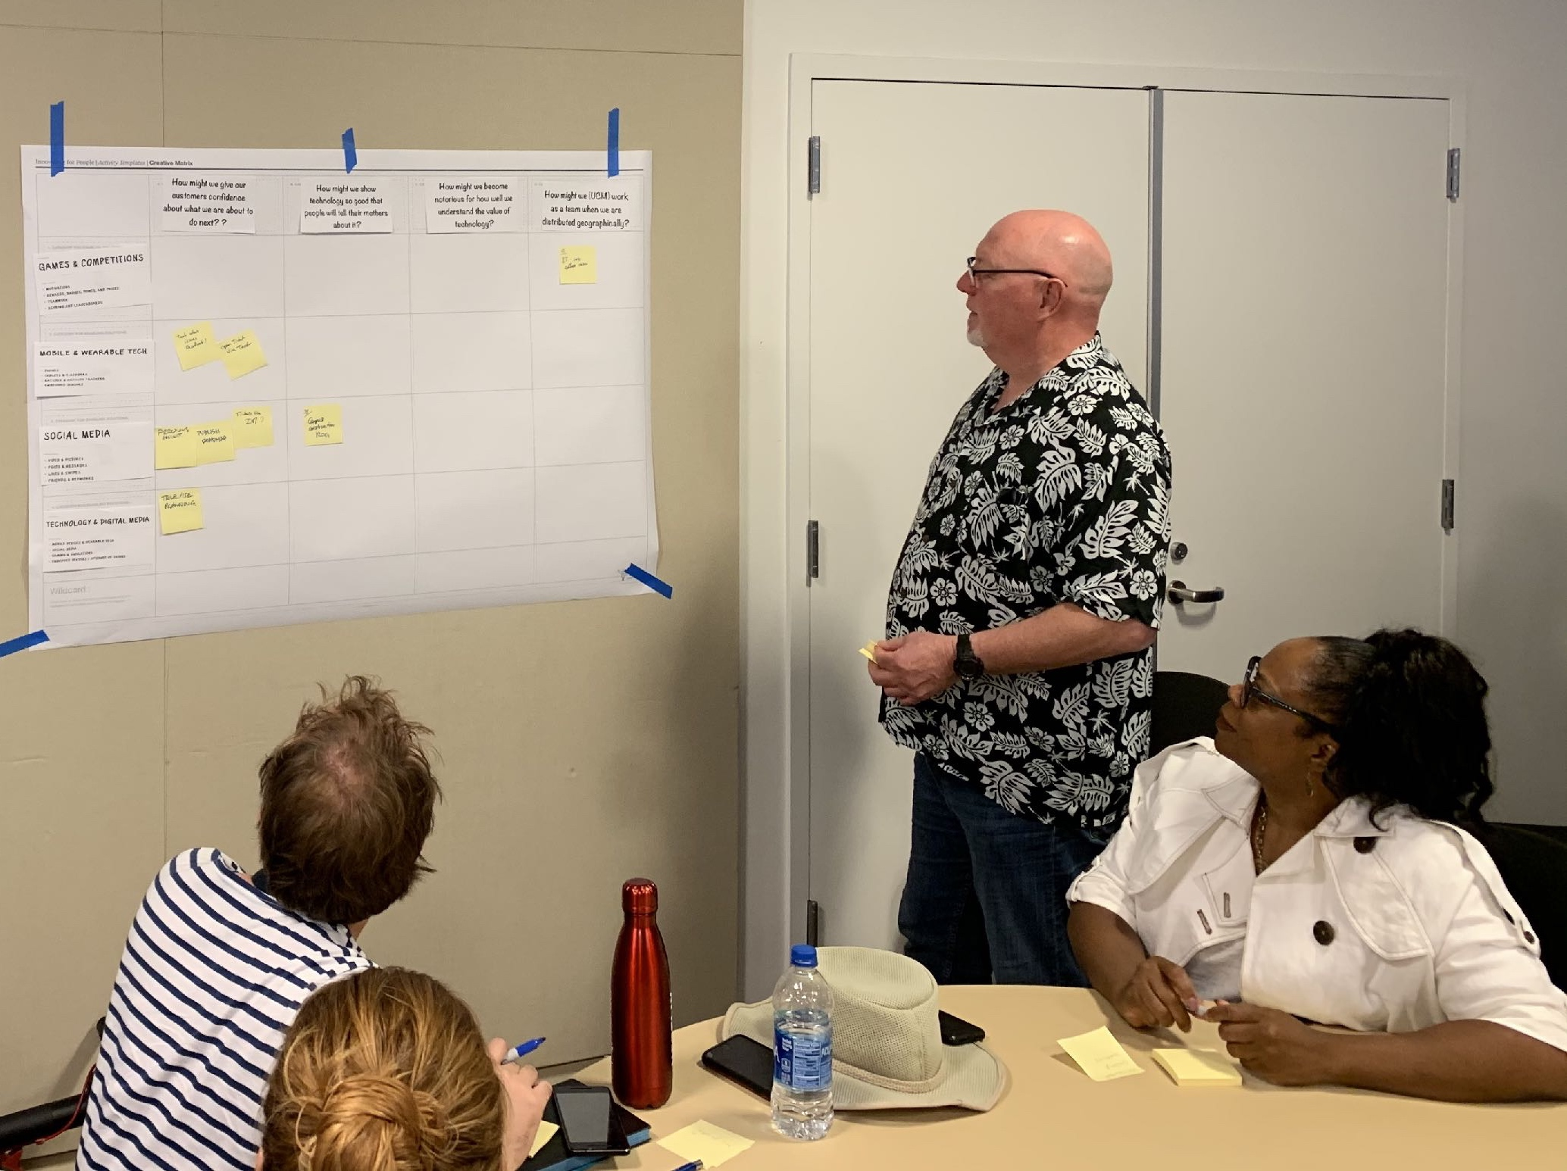
IMPLEMENTATION PLAN

Slide 19

QUICK WINS
App Inventory
IMPLEMENTATION PLAN
IT Onboarding
Staff-Curated OIT Services
Enterprise App Roadmap
OIT Roadmap (handout)

Slide 20
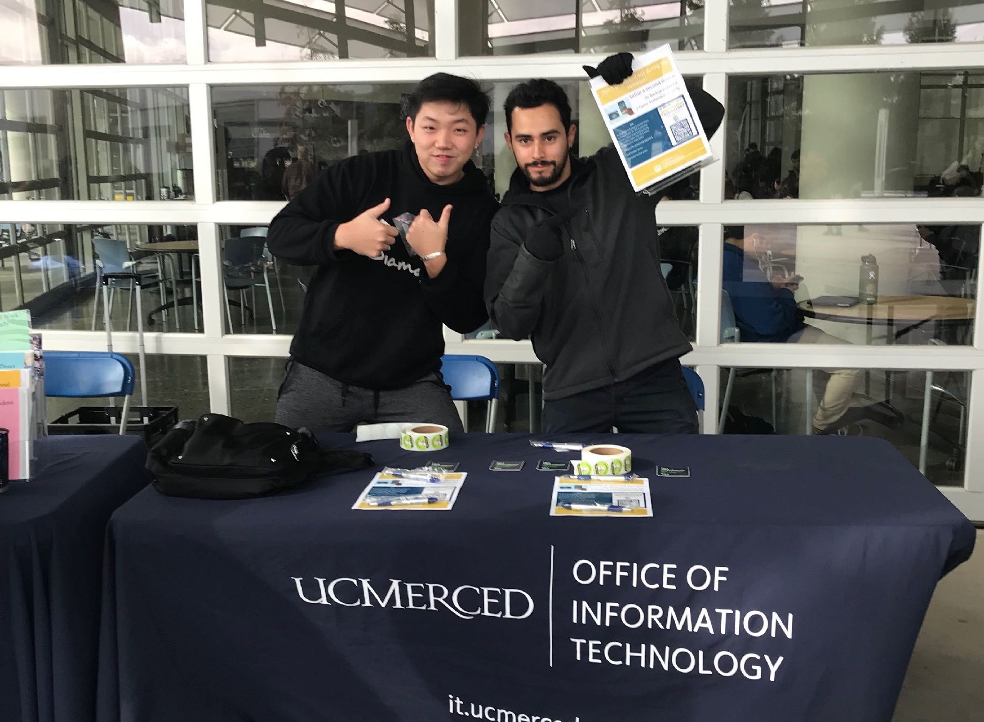




ENGAGEMENT
IMPLEMENTATION PLAN
Yearly tech-based event showcasing services, projects, and resources
LISTENING EVENTS
Continuing quarterly stakeholder engagement
WEBINARS
Monthly webinars on critical topics identified through listening events and OIT planning.

Slide 21
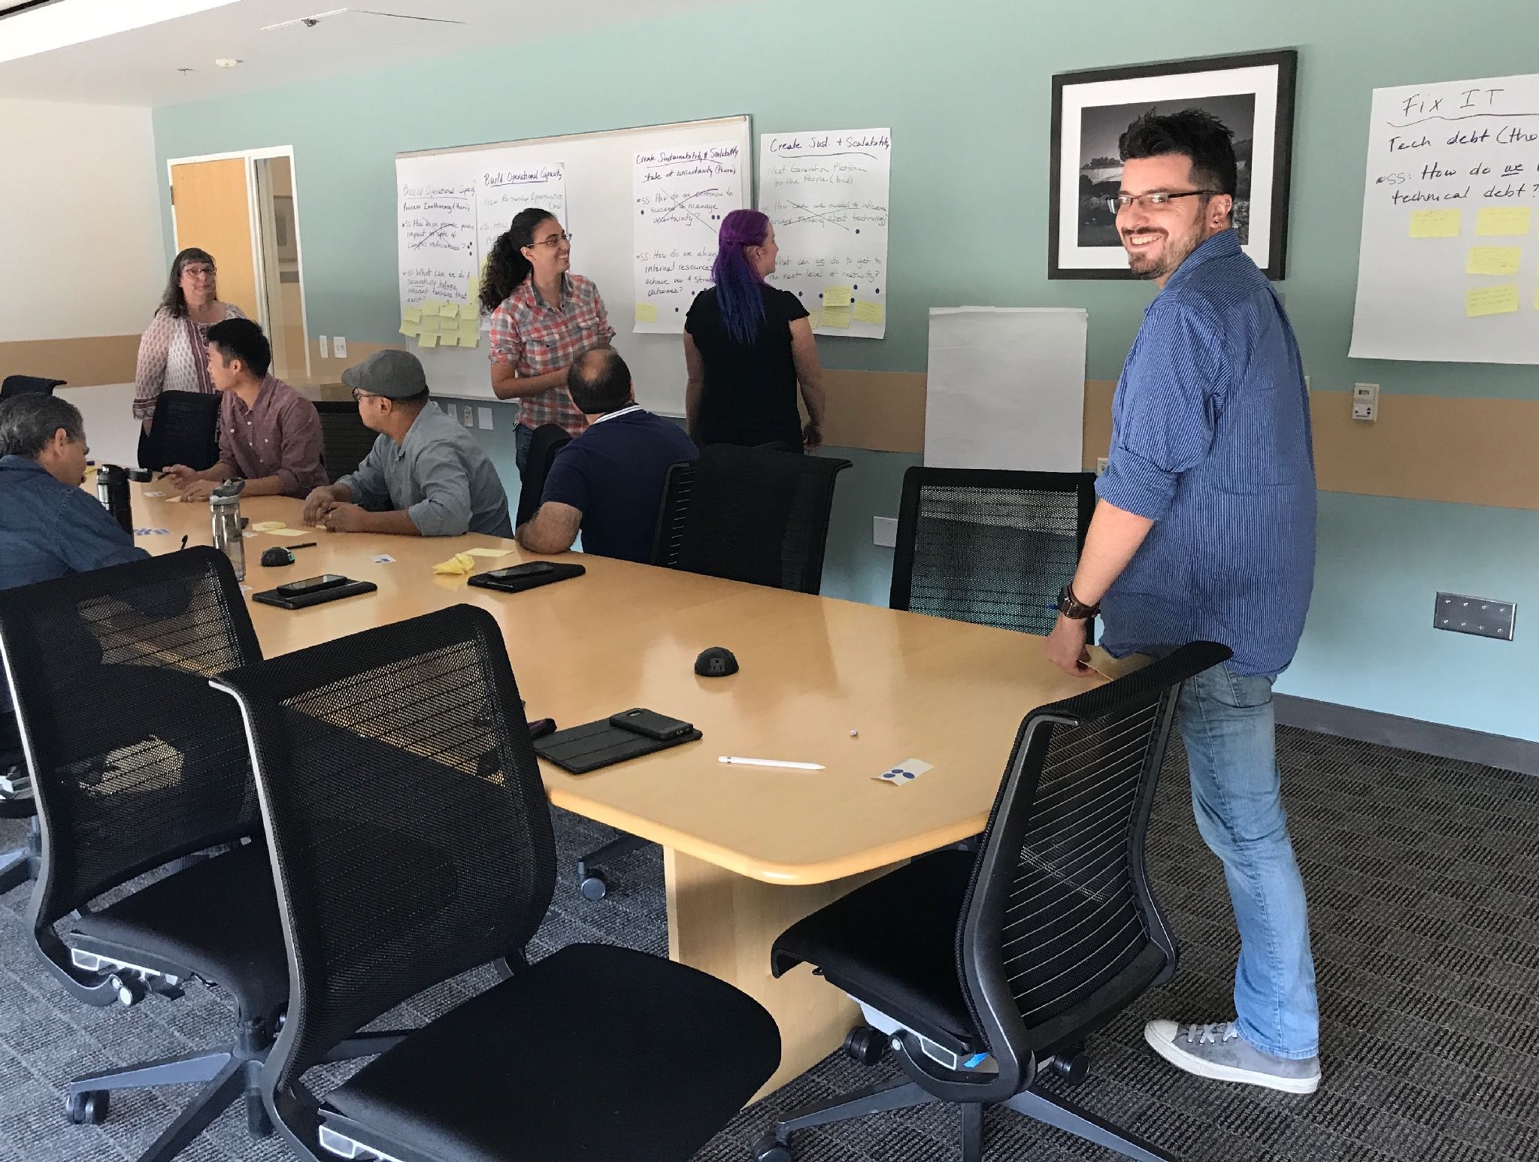
POSSIBLE WEBINAR TOPICS INCLUDE:
ENGAGEMENT
IMPLEMENTATION PLAN
OIT PROCESSES
OIT SERVICES
Technology & Change Management Technology & Flexible Work
My Big Fat Pain Point Economics of IT Differing Perspectives on IT The Importance of Data Backups Scrum Methodologies
Product Showcase – Box, Zoom
IT Basics at UC Merced
A Day in the Life in OIT
New Service Demo - VPN
Identity Management & 2FA
GENERAL IT TOPICS
How We Manage an Incident
How Networks Work Service Transition Anatomy of a Project Cloud Computing
EMERGING TECHNOLOGIES
Wearables & Sensors Virtual Agents
Emerging Research Technologies

Slide 22
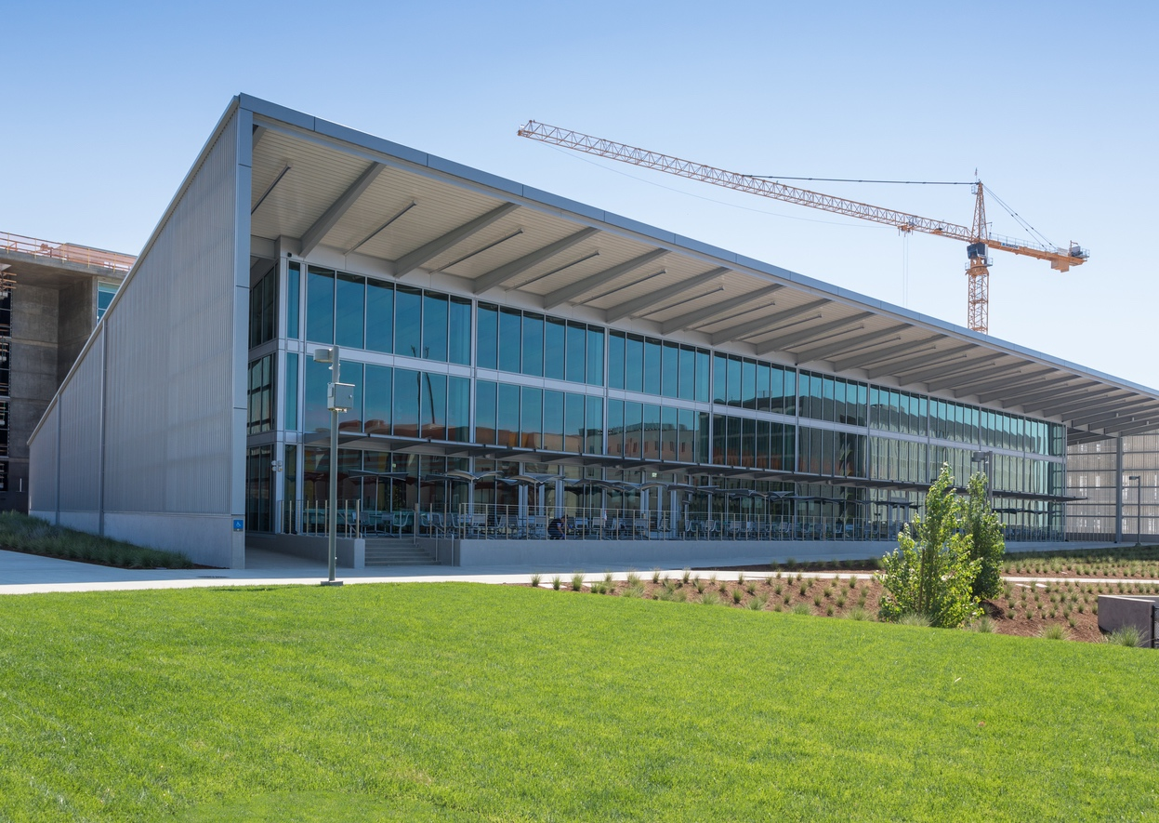
CURRENT STATE
IMPLEMENTATION PLAN
OIT will design, deliver, and refine training and support solutions that enable self-service, leverage the OIT knowledge base, and improve the UC Merced OIT technology experience for faculty, staff and students.
OIT Goals Strategy
1
Projects
2
OIT will develop and track key performance indicators (KPIs) that demonstrate continuous improvement across divisions.
OIT will define and publish standards for infrastructure, applications, data, business operations, financial planning, & communications for use in developing technical roadmaps, project management best practices and service transition and delivery.
IT Website
3
Change Management & Lean Six Sigma Investments

Slide 23
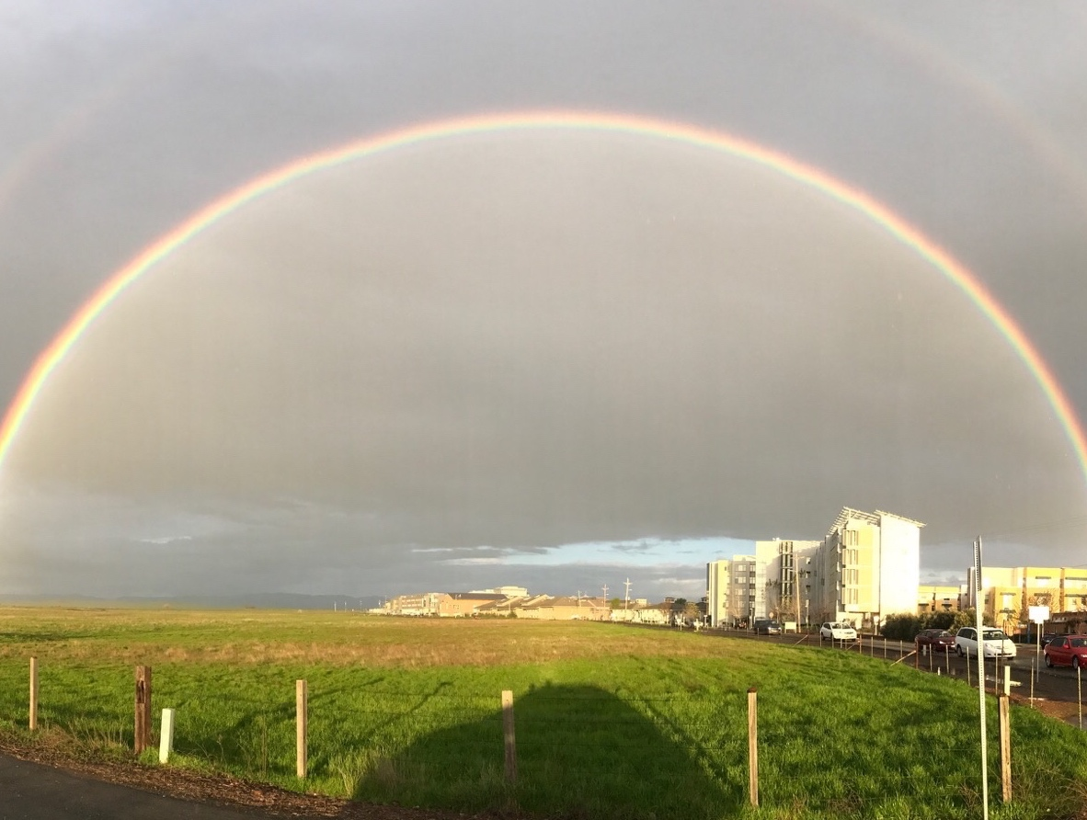
MOVING FORWARD
IMPLEMENTATION PLAN
Partnership with Campus Units
Joint Council Updates
Faculty Advisory Committee (Academic Senate)
IT Global Funding Model
Student Input
Campus Integrated Planning Process Run | Grow | Transform

Slide 24

Thank You For Reading

